Slide 1
Current Progress in computational metabolomics
2007 Briefings in Bioinformatics
Presenters
Alan Baer
Sumana Kalyanasundaram
Adam Fleming

Slide 2
Topics
Introduction:
  Overview of metabolomics
  Introduction to computational metabolomics
Metabolomics
  (i) Metabolomics databases; (ii) Metabolomics LIMS; (iii) Spectral analysis tools for metabolomics and (iv) Metabolic modeling.
Discussion
  Summary
  Current progress and developments

Slide 3
Introduction
The metabolome is a close counterpart to the genome, the transcriptome and the proteome. Together these four ‘omes’ constitute the building blocks of systems biology.
Metabolomics is a newly emerging field of research concerned with the high-throughput identification and quantification of the small molecule metabolites in the metabolome.
The metabolome can be defined as the complete complement of all small molecule (<1500 Da) metabolites found in a specific cell, organ or organism.
Metabolites are small molecules that are chemically transformed during metabolism and can provide a functional readout of the cellular state. Metabolites, unlike genes and proteins, serve as direct signatures of biochemical activity and are much easier to correlate with phenotype.
Notes:
systematic study of the unique chemical fingerprints that specific cellular processes leave behind
Epigenetic//postranstlational

Slide 4
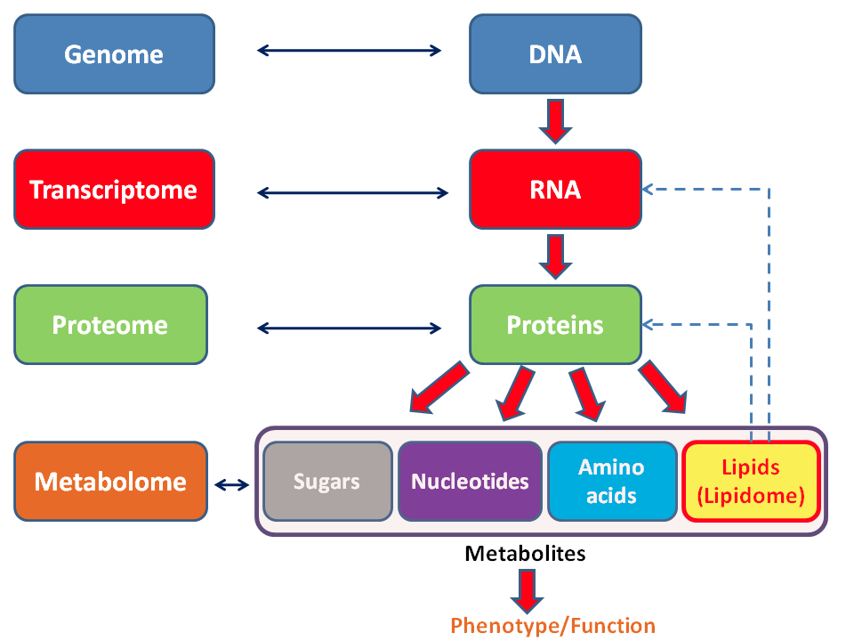
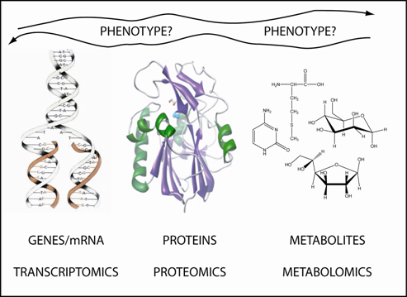
One of the challenges of systems biology and functional genomics is to integrate proteomic, transcriptomic, and metabolomic information to give a more complete picture of living organisms.
While mRNA gene expression data and proteomic analyses do not tell the whole story of what might be happening in a cell, metabolic profiling can give an instantaneous snapshot of the physiology of that cell.

Slide 5
Metabolomic Experimental Design Considerations
Targeted vs Untargeted
Identifying the number and type of metabolites to be measured.
In targeted metabolomics, known metabolites for specific pathways are targeted. This approach typically used to answer specific biochemical questions in pharmokinetic studies of drug metabolism as well as for measuring the influence of theraputics or genetic modifications on a specific enzyme.
Untargeted metabolomics are global in scale and have the goal of simultaneously measuring as many metabolites as possible from biological samples without bias in order to generate a metabolic profile of a sample.
Notes:
Large data files, several gigs per sample

Slide 6
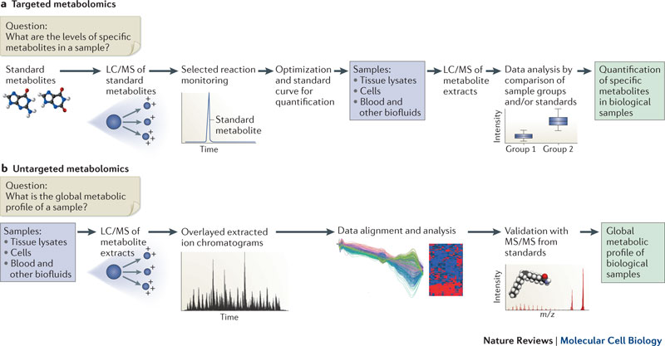
Typical Workflow for Targeted or Untargeted LC/MS based Metabolomics

Slide 7
Comparisons and Challenges Specific to Metabolomics
Whereas most data in the field of proteomics, genomics or transcriptomics is readily available and analyzed through electronic databases, most metabolomic data is still resident in books, journals and other paper archives.
Metabolomics differs from other ‘omics’ fields because of its strong emphasis on chemicals and analytical chemistry techniques such as (nuclear magnetic resonance) NMR, mass spectrometry MS and chromatographic separations LC, this along with the need for the de novo characterization of unknown metabolites through traditional means represents unique challenges.
Issues
  Complex profiles: Differentiating metabolomic profiles from often heterogeneous tissue samples.
  Multiple identifying peaks (m/z values) for the same metabolite.
  Validation and identification of thousands of LC/MS identified metabolites with known reference standards via MS/MS.
  Standardization of sample preparation and reads along with unifying data obtained from different instruments.
  Sample collection bias.
Notes:
Mass/Charge
Ph / temp / sample retention/ aqueous vs organic solvents when separating via LC hydrophilic vs hydrophobic sample bias

Slide 8
Challenges
Metabolomics is not only concerned with the identification and quantification of metabolites, it is also concerned with relating metabolite data to biology and metabolism. As a result, metabolomics requires that whatever chemical information it generates must be linked to both biochemical causes and physiological consequences. This means that metabolomics must combine the two very different fields of informatics: bioinformatics and cheminformatics.
As a result, the analytical software used in metabolomics is fundamentally different from any of the software used in genomics, proteomics or transcriptomics.
As in all fields, metabolomics require electronically accessible and searchable databases, all of them require software to handle or process data from their own high-throughput instruments (DNA sequencers for genomics, microarrays for transcriptomics, mass spectra (MS) for proteomics), all of them require laboratory information management systems (LIMS) to manage their data, and all require software tools to predict or model properties, pathways, relationships and processes.

Slide 9
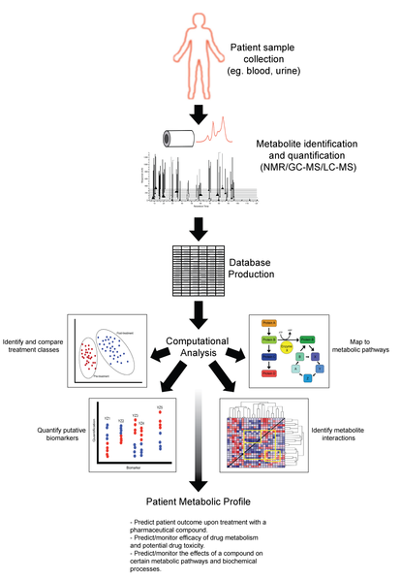
Typical workflow for generating a metabolic profile

Slide 10
Metabolomic LIMS and Data Standards

Slide 11
To make metabolomics fully integrated with omics the data has to be:
Managed
Stored
Standardized
Standardization efforts proved to be critical to the success and growing uniformity of many techniques in genomics, transcriptomics and proteomics
Achieving data standardization through the development, distribution and widespread use of mark-up languages (XML, CellML, SBML) and bio-ontologies

Slide 12
Mark-up Languages
XML
  Transport and store data
CellML
  Store and exchange computer based mathematical models
  Share models even if they use different modeling tools
  Reuse components from one model to another.
SBML
  Machine-readable format for representing models
Notes:
CellML is to store and exchange computer-based mathematical models. CellML allows scientists to share models even if they are using different modelling tools. It also enables them to reuse components from one model in another, thus accelerating model development.

Slide 13
Challenges & Solution
key challenges in computational metabolomics lies in developing standardized protocols for converting and archiving instrument data to a common format suitable for any kind of mathematical analysis
Solution
  NetCDF (Network Common Data Form)
    Mahine-independent file protocol for creating, sharing, saving scientific data of any kind.
    Self-describing, portable, directly accessible, appendable, sharable and archivable
  ANDI (analytical data interchange protocol)
    Specific protocol for saving HPLC, UPLC, CE, FTIR, and mass spectrometry data.
Notes:
NetCDF was developed by the Unidata Program Center in Boulder, Colorado
It was originally implemented by the Analytical Instrument Association (AIA) and is supported by a number of instrument manufacturers. More importantly, ANDI is based on the NetCDF file protocol. More details about these file protocols

Slide 14
LIMS
Computer software system that is used in the laboratory for the management of samples, laboratory users, instruments, standards, workflow automation and other laboratory functions
Electronic-record-keeping systems.
Coordinating large-scale, multi-lab or multi-investigator. projects Supports data time stamps and regular back up, resource (equipment) and personnel management, data validation, lab audits and the maintenance of lab and data security (an audit trail)
Designed to handle large quantity of data
Notes:
Useful for coordinating large-scale, multi-lab or multi-investigator projects and in bringing some semblance of uniformity to input data
Since LIMS are designed to handle large quantities of very heterogeneous data, they have become a mainstay of many ‘omics’ efforts around the world. Not only are LIMS important for the day-to-day lab management of many of today's large-scale genomic and proteomic experiments, LIMS also play a crucial role in defining what kinds of data will reside in public databases; what kind of data exchange standards will be used for a given field; what kinds of common vocabularies or ontologies should be adopted and what kinds of meta data should be captured during a given experiment. Over the past decade, a number of excellent LIMS have been developed and described for DNA sequencing, MS-based proteomics, transcriptomis and structural proteomics.

Slide 15
Metabolomic LIMS
Just beginning to be developed and implemented
SetupX
  Developed by Fiehn laboratory at UCSD
  Web-based
  XML compatible and built around a relational database management
  Displays GC-MS metabolic data through its metabolic annotation database called BinBase
  Originally based on ArMet
  Very flexible , handles wide variety of BioSources and Treatments
  Uses publicly available taxonomic and ontology repositories
  Uses NCBI taxonomy tables to enable generalized queries
  Well designed and well tested.
Notes:
ArMet- Architecture for a metabolomic experiment
SetupX was designed to be very flexible, being able to handle a wide variety of BioSources (spatial, historical, environmental and genotypic descriptions of biological objects undergoing metabolomic investigations) and Treatments (experimental alterations that influence the metabolic states of BioSources).
use of publicly available taxonomic and ontology repositories to ensure data integrity and logical consistency of its BioSource and Treatment data. For example, selection of BioSource ‘rat’ and a plant organ ‘leaf’ is prevented in SetupX.
It makes use of many leading-edge computational techniques and employs many of the recommendations made by various standing committees on metabolomic data exchange and data entry

Slide 16
Metabolomic LIMS
Sesame
  Web-based, platform-independent metabolomic LIMS
  RDMS (SQL and JAVA)
  NMR-based structural genomics studies
  Tools to facilitate collaborative analysis, access and visualization of data
  Sample tracking and bar coding , SOP or procedures
  ‘Lamp’ for metabolomics- Arabadopsis using NMR
  Flexible and adaptable to other biological systems
  Has several ‘Views’- components found in metabolomic experiments
  Facilitates data capture, editing , process analysis, retrieval and report generation
Notes:
Small Molecule, Detailed Small Molecule, Sample, Mass Sample, NMR Experiment, Software, Hardware, Vendo

Slide 17
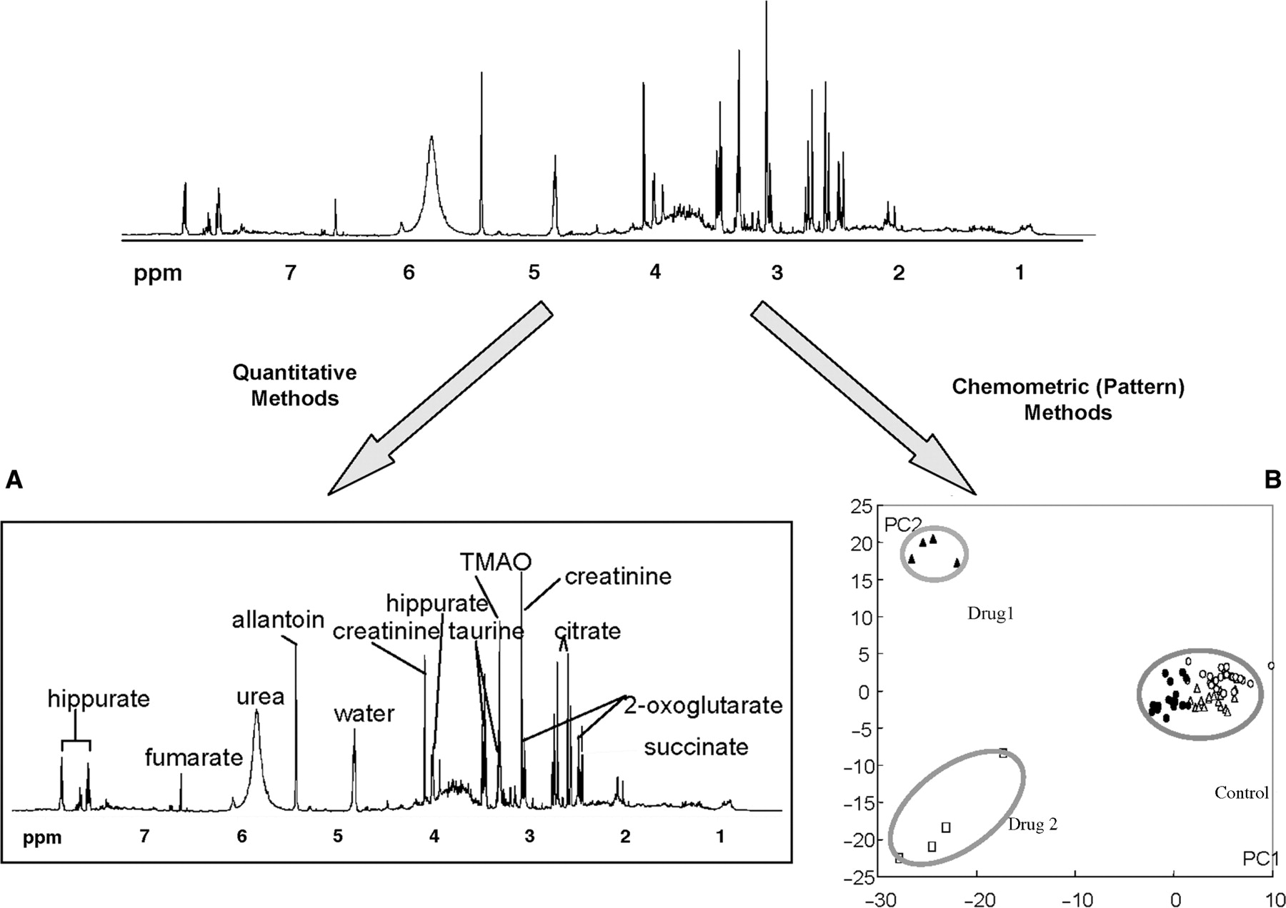
Spectral Analysis Tools for Metabolomics
Large numbers of metabolites are rapidly measured using non-chemical and non-colorimetric methods such as GC-MS, LC-Ms, CE, FT-MS or NMR spectroscopy
Two routes for collecting, processing and interpreting metabolomic data
  Spectral patterns and intensities are recorded, compared and used to make diagnoses
  Target profiling-compounds
  are formally identified and quantified

Slide 18
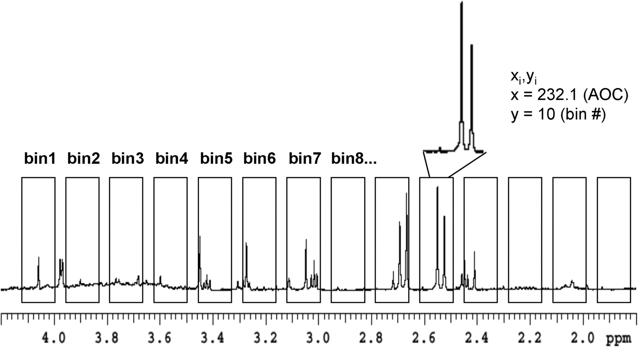
Chemometrics and metabolomic data
Application of mathematical, statistical, graphical or symbolic methods to maximize information that can be extracted from chemical or spectral data.
Extract useful info from complex spectra
Identifies statistically significant differences between large groups of spectra.
Uses divide and conquer approach using binned spectrum

Slide 19
Principal Component Analysis(PCA)
Data reduction technique- optimal linear transformation for a collection of data points
Difference between two samples
Quantifies the amount of useful info or signal in the data
Sensitive to experimental noise
Higher order arrays using PARAFAC (parallel factor analysis)
Other techniques SIMAC, PLS-DA, k-means clustering.
Notes:
PCA determines an optimal linear transformation for a collection of data points such that the properties of that sample are most clearly displayed along the coordinate (or principal) axes
how one sample is different from another, which variables contribute most to this difference and whether those variables contribute in the same way (i.e. are correlated) or independently (i.e. uncorrelated) from each other
while PCA methods work well for analyzing binned NMR, GC–MS or HPLC data (i.e. data with peak height and peak location), PARAFAC methods can be applied to three (and higher) dimensional GC–GC–MS data, 2D–HPLC–MS data or 3D-NMR data.
SIMCA (Soft Independent Modeling of Class Analogy), PLS–DA (Partial Least Squares—Discriminant Analysis) and k-means clustering.

Slide 20
SIMCA
Soft independent modeling of class analogy
Maps data onto lower dimensional subspace
Uses cross validation or training to perform classification
Sensitive to quality of the data
Examples: classify teas, different types of whiskeys, metabolic phenotyping of nude and normal mice using NMR.
Notes:
If the residual variance of a sample exceeds the upper limit for every modeled class in the data set, then the sample would not be assigned to any of the existing classes because it is either an outlier or comes from a class that is not represented in the data set.

Slide 21
PLS-DA
Information about class identities has to be provided by the user.
Sharpens the separation between groups by rotating PCA components.
Regression or categorical extension of PCA in attempt to maximize the separation.
In combination with infrared spectroscopy is used to classify geographic location of wines, to look at gender differences in urinary glucuronides via MS-TOF studies, and to identify biomarkers in cerebrospinal fluid via SELDI-MS

Slide 22
TARGETED METABOLIC PROFILING
The compounds in biofluid or tissue extract is identified and quantifies by comparing the biofluid spectrum to a library of reference spectra of pure compound.
Spectra from biofluid is sum of all the individual spectra
Use of NMR-curve fitting software and special database
Most metabolites have unique chemical shift fingerprints that helps reduce redundancy.
It is not restricted to NMR or GC-MS.
MS fingerprint library determined from a triple-quad instrument
LC-MS requires soiking with isotopically labeled derivatives

Slide 23
Advantage:
  Does not require collection of identical data so more amenable to human studies
  Large range of statistical and machine learning approach like artificial neural networks(ANNs), support vector machines(SVMs) and Decision Trees(DTs)
  ANNs: used to identify action of herbicides on plant biochemical pathways.
Disadvantage
  Limited size of current spectral libraries

Slide 24
Metabolic Modeling
Necessity for connecting metabolic data with biological causes
Metabolic models traditionally done by solving ordinary differential equations (ODEs)
  These describe the chemical reactions and the system of interest
Many metabolic models exist to do this
  GEPASI, CellDesigner, SCAMP, and Cellerator

Slide 25
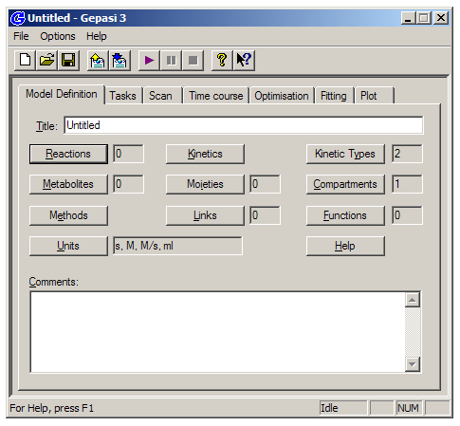
Metabolic Modeling
Allows users to enter kinetic equations of interest and the parameters for those equations
Solves ODE’s and generates user friendly outputs

Slide 26
Metabolic Modeling
Alternatively constraint-based modeling can be used
  Uses physiochemical constraints (mass balance, energy balance, or flux limitations) to describe a large system
  Time and rate constraints can be ignored in these models, interested in steady state conditions that meet physiochemical criteria
  Useful for large-scale studies
Flux-based analysis (FBA) commonly used for this

Slide 27
Metabolic Analysis
FBA requires knowledge of stoichiometry of reactions involved
  These sets of reaction are used to define the metabolic network
  Assumes steady state will be reached constrained by stoichiometry of reactions
Normally not enough stoichiometric constraints
  Addition of information of all feasible metabolite fluxes and specific min/max fluxes for each reaction
FBA can further be refined by using experimental data

Slide 28
Metabolic Analysis
Once the model is optimized using the stoichiometric constraints it can be used to generate predictive models of cellular metabolism
Mass balance is key to FBA model success
  Flux of metabolites through each reaction and stoichiometry of that reaction
FBA’s have been used in a variety of metabolomic studies, and have been used in genome scale modeling of many bacterial systems
  Lactococcus lactis, Helicobacter pylori, Escherichia coli, etc.

Slide 29
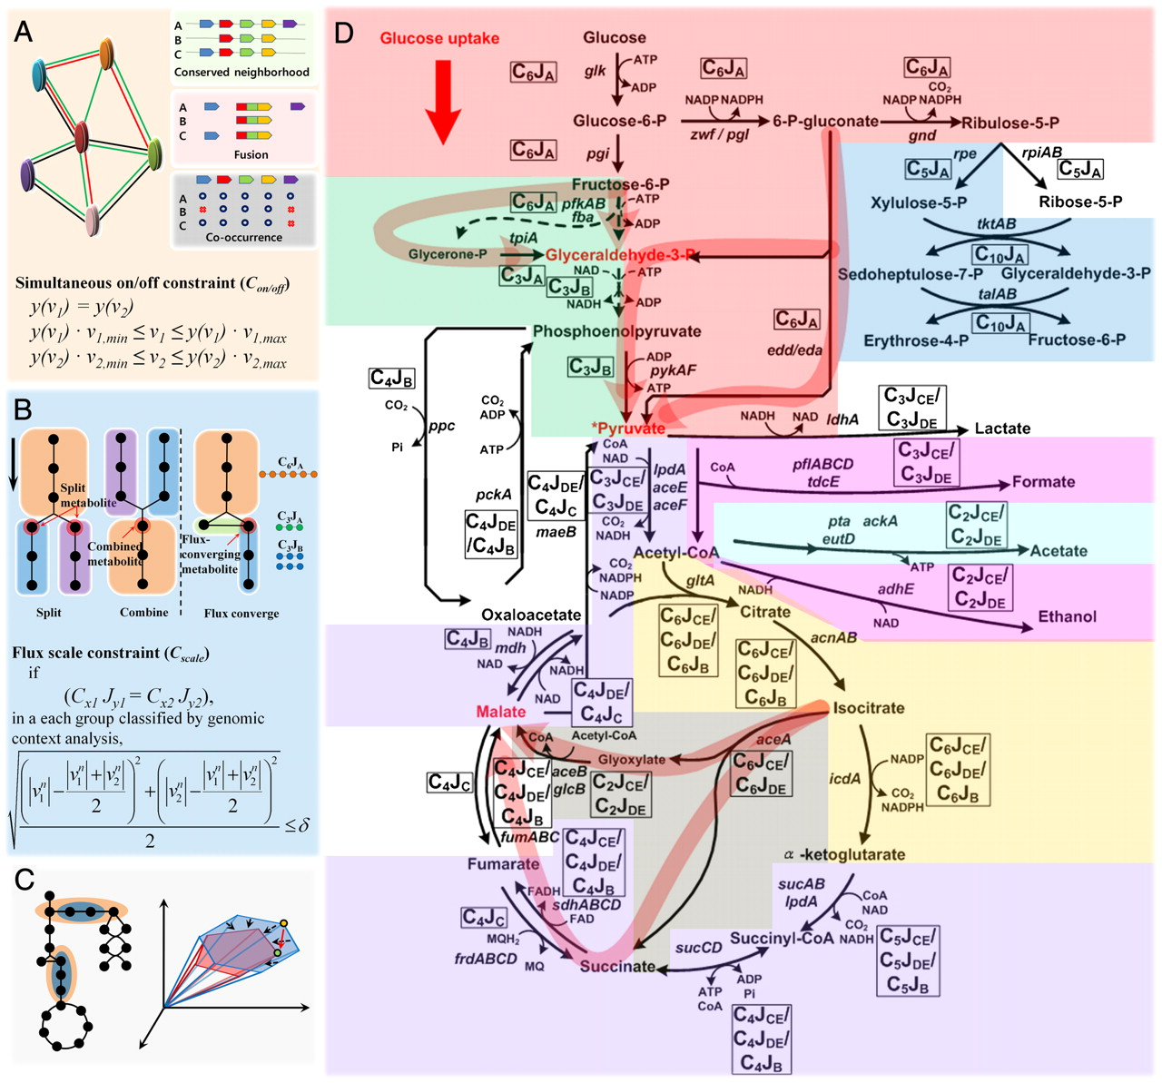
Flux based analysis model of glycolysis and the citric acid cycle:

Slide 30
Conclusions
Computational metabolomics will integrate more and more with systems biology
  Focus on quantitative with a focus on temporal and spatial data
Trend towards rapid/high throughput identification and quantification
Rise of organism specific metabolite databases
  Just as with genome and proteome databases
Basically follow in the footsteps of genomics and proteomics

Slide 31

New Developments
Rise of species specific metabolite data bases as predicted
  ECMDB: E. coli metabolome database
  YMDB: Yeast metabolome database
  HMDB: Human metabolome database
Increased application of new techniques to oncology and disease profiling
  Cancer metabolite profiling already exists

Slide 32
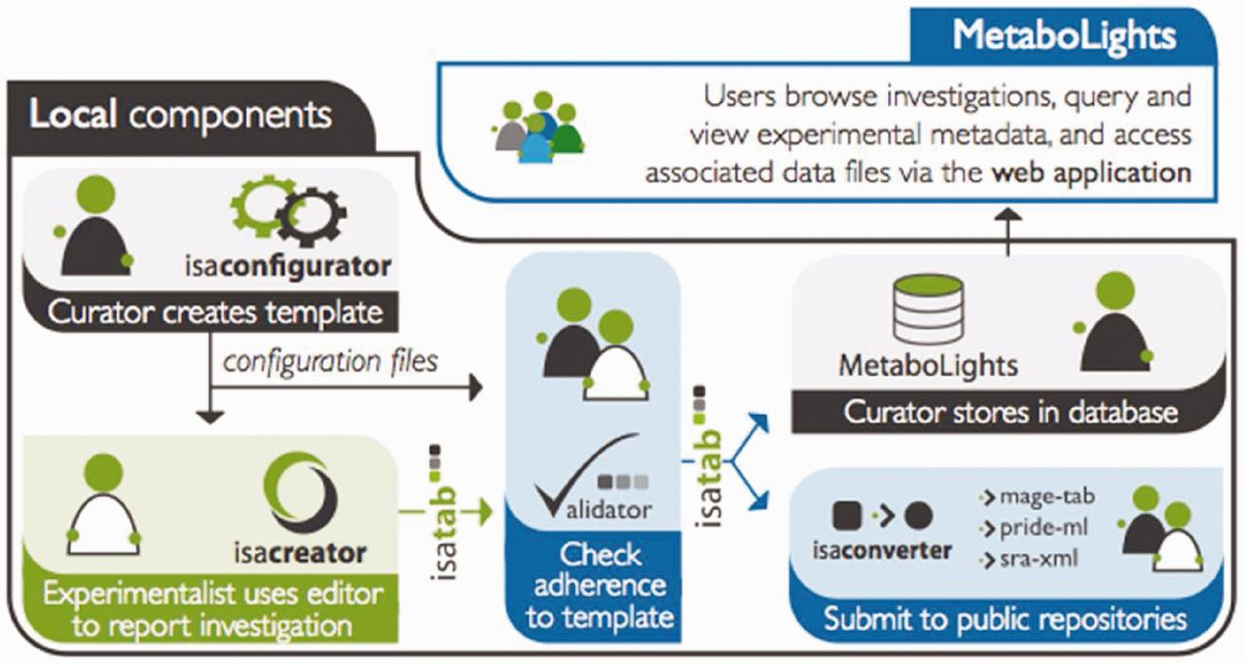
New Developments
Active development of new LIMS systems focused on metabolomics
  MetaboLights from EMBL and Cambridge. Multi-species and multi-application compatible with all existing open metabolomics standards

Slide 33
Questions?

